Slide 1
Welcome to Active Schools Launch Week Finals Friday

Slide 2
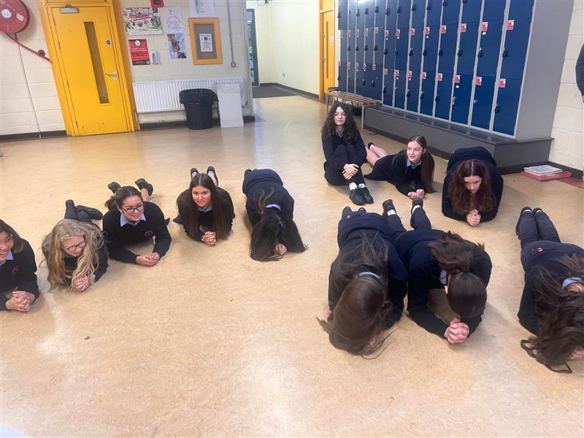
1 Dunree

Slide 3
2 Foyle

Slide 4
1 Mizen
1 Calais

Slide 5
4 Joyce

Slide 18
Welcome to Active Schools Launch Week Finals Friday

Slide 19
Finals Friday Prizes

Slide 20
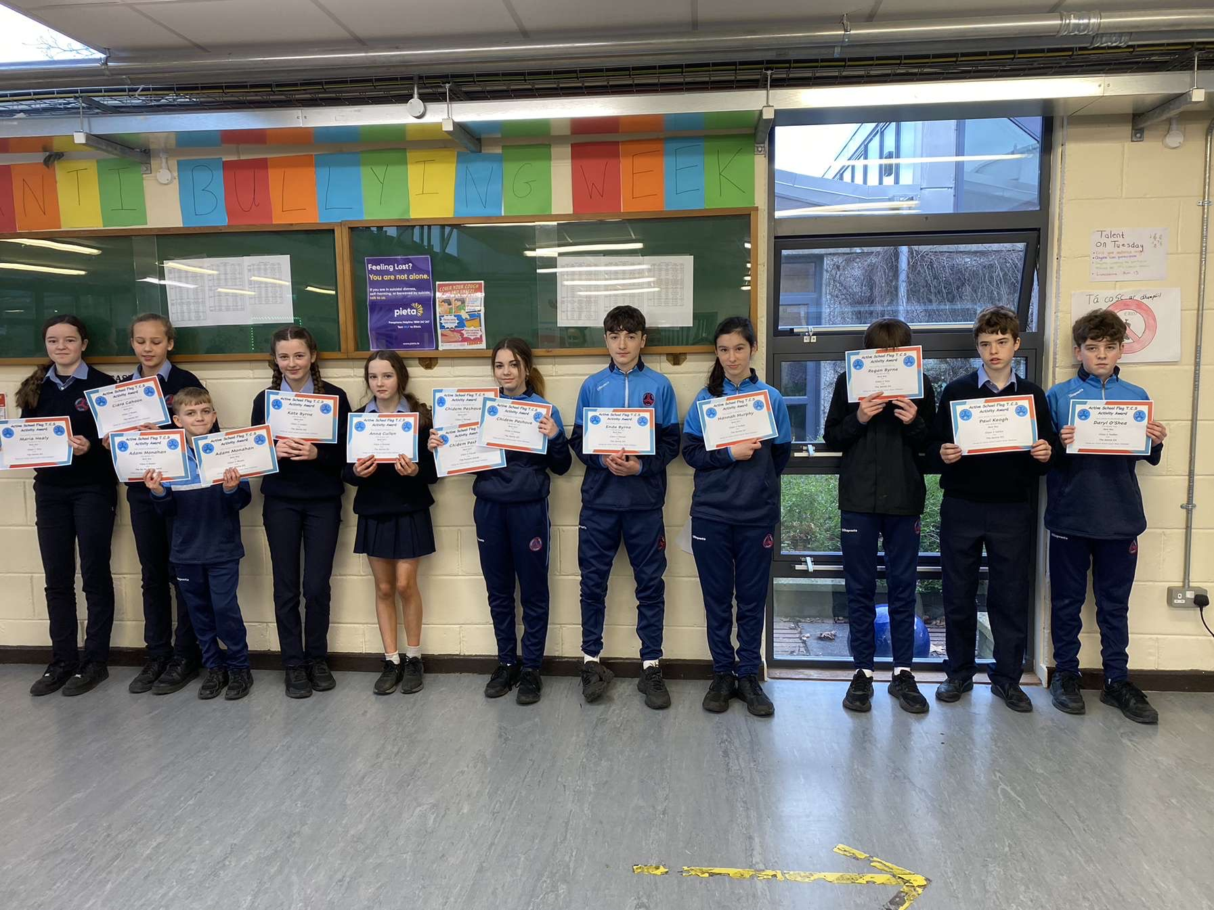
1st Year Finalists

Slide 21
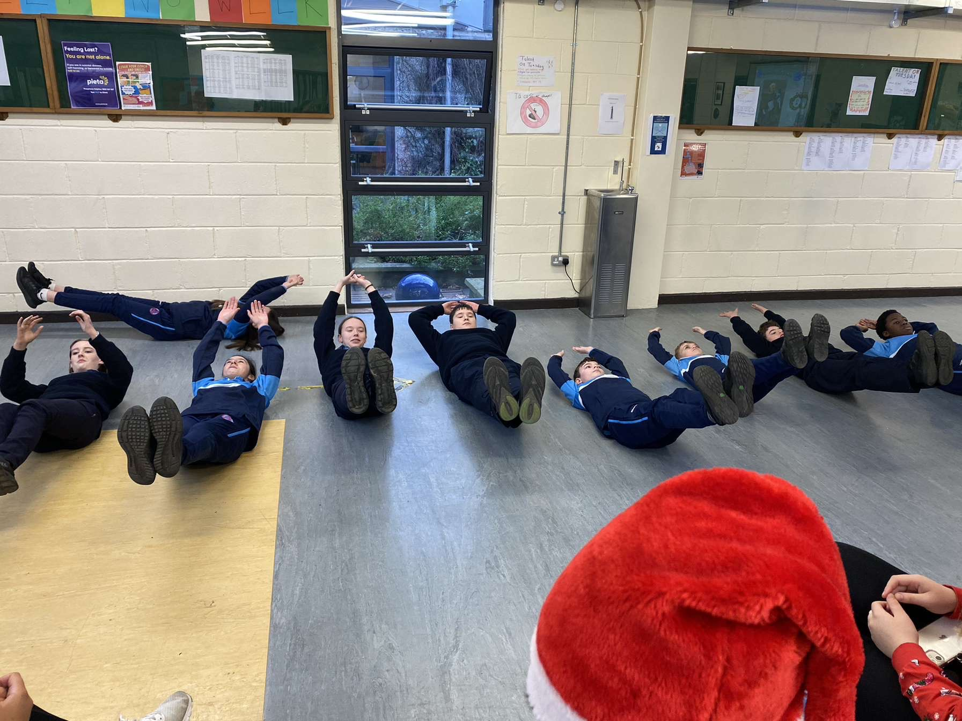
1st Year Finalists

Slide 22
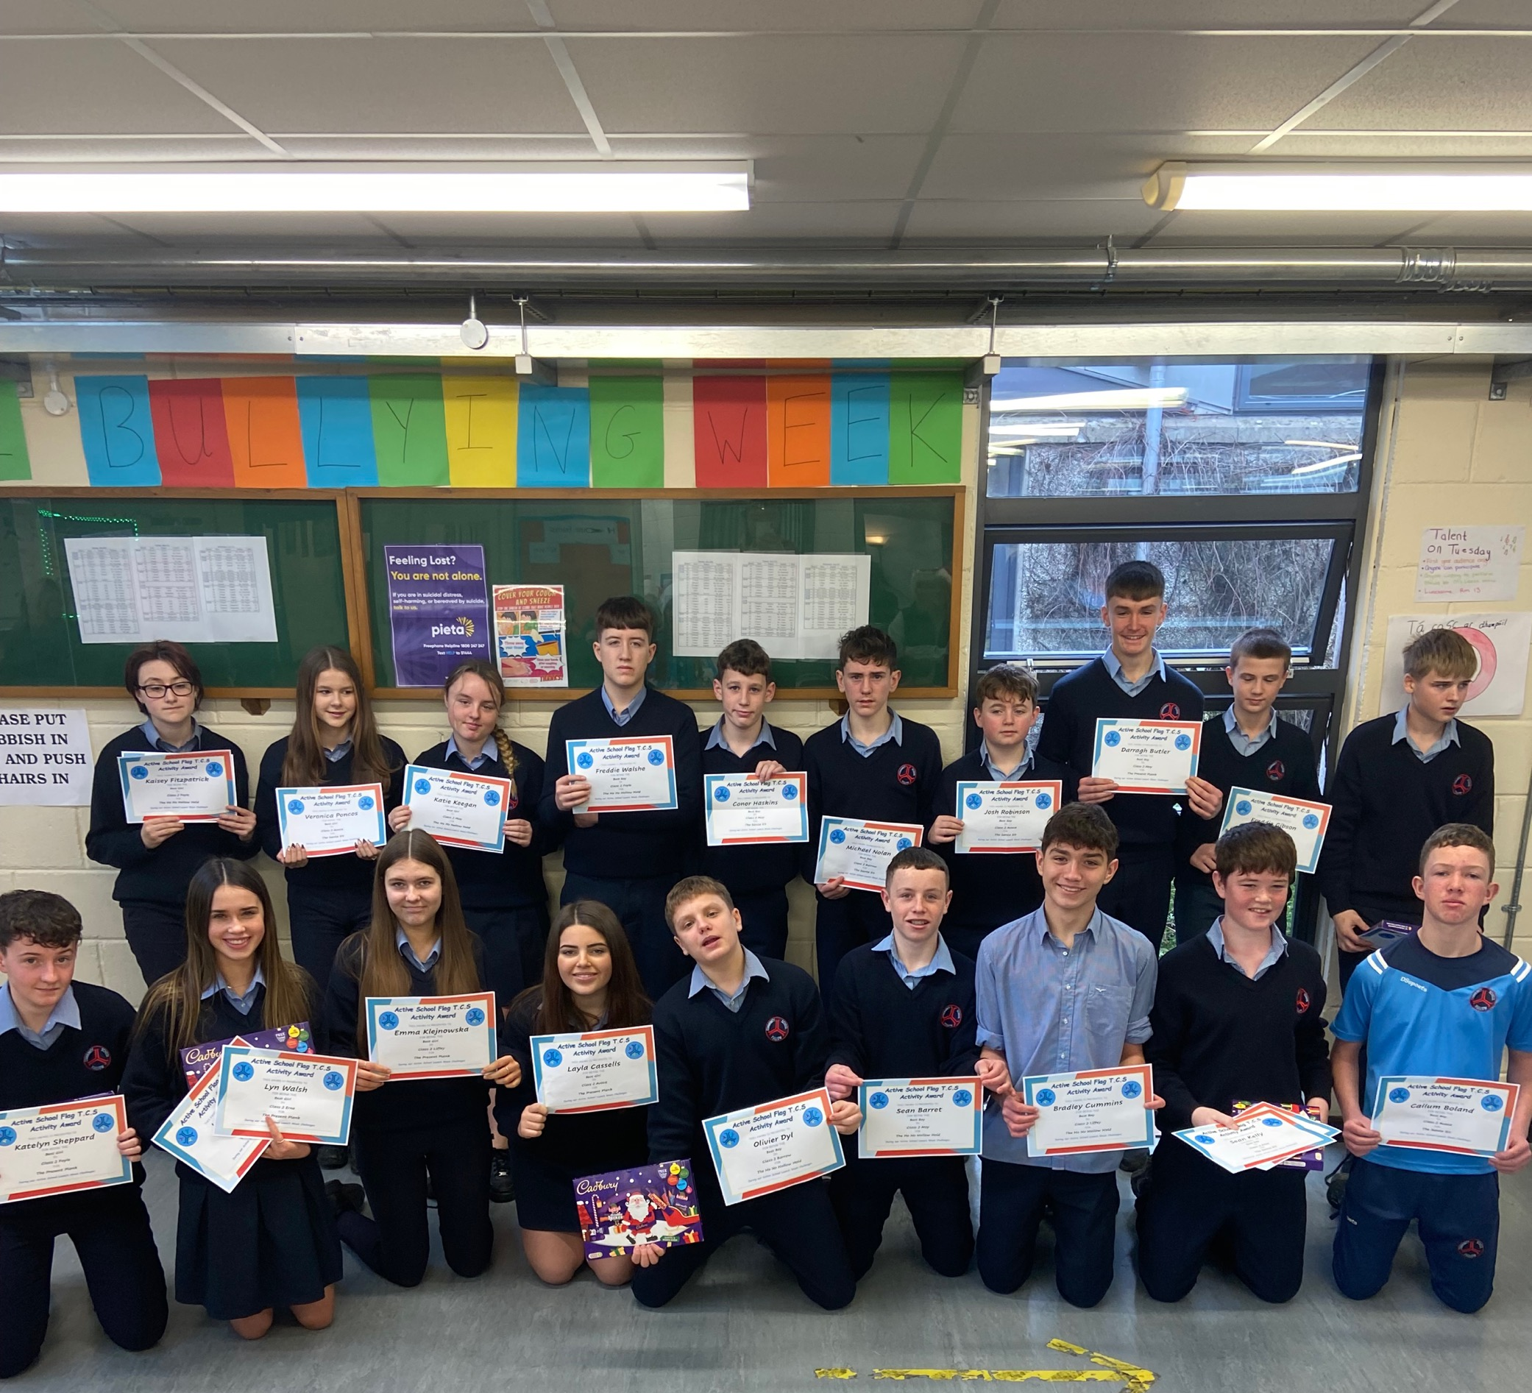
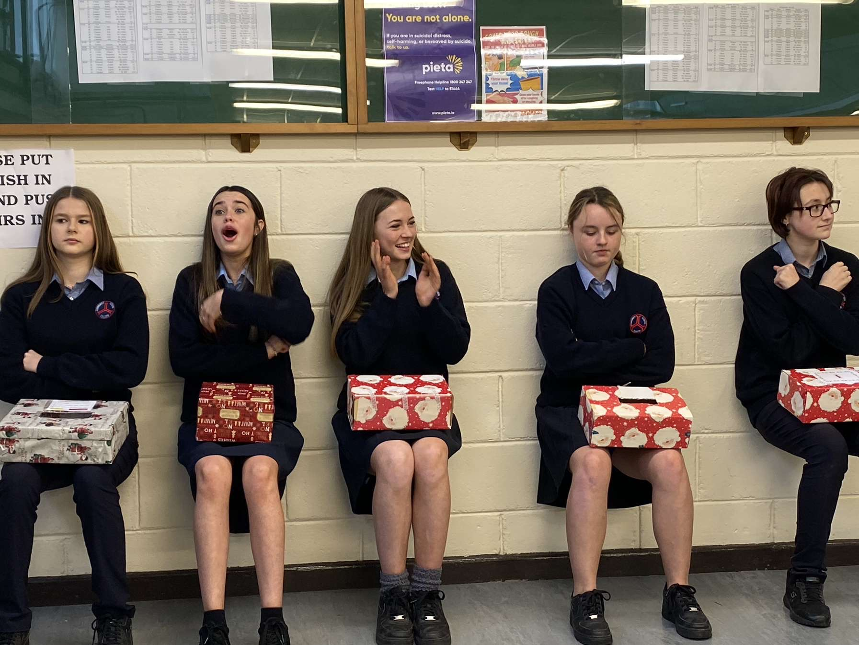
2nd Year Finalists

Slide 23
3rd Year Finalists

Slide 24
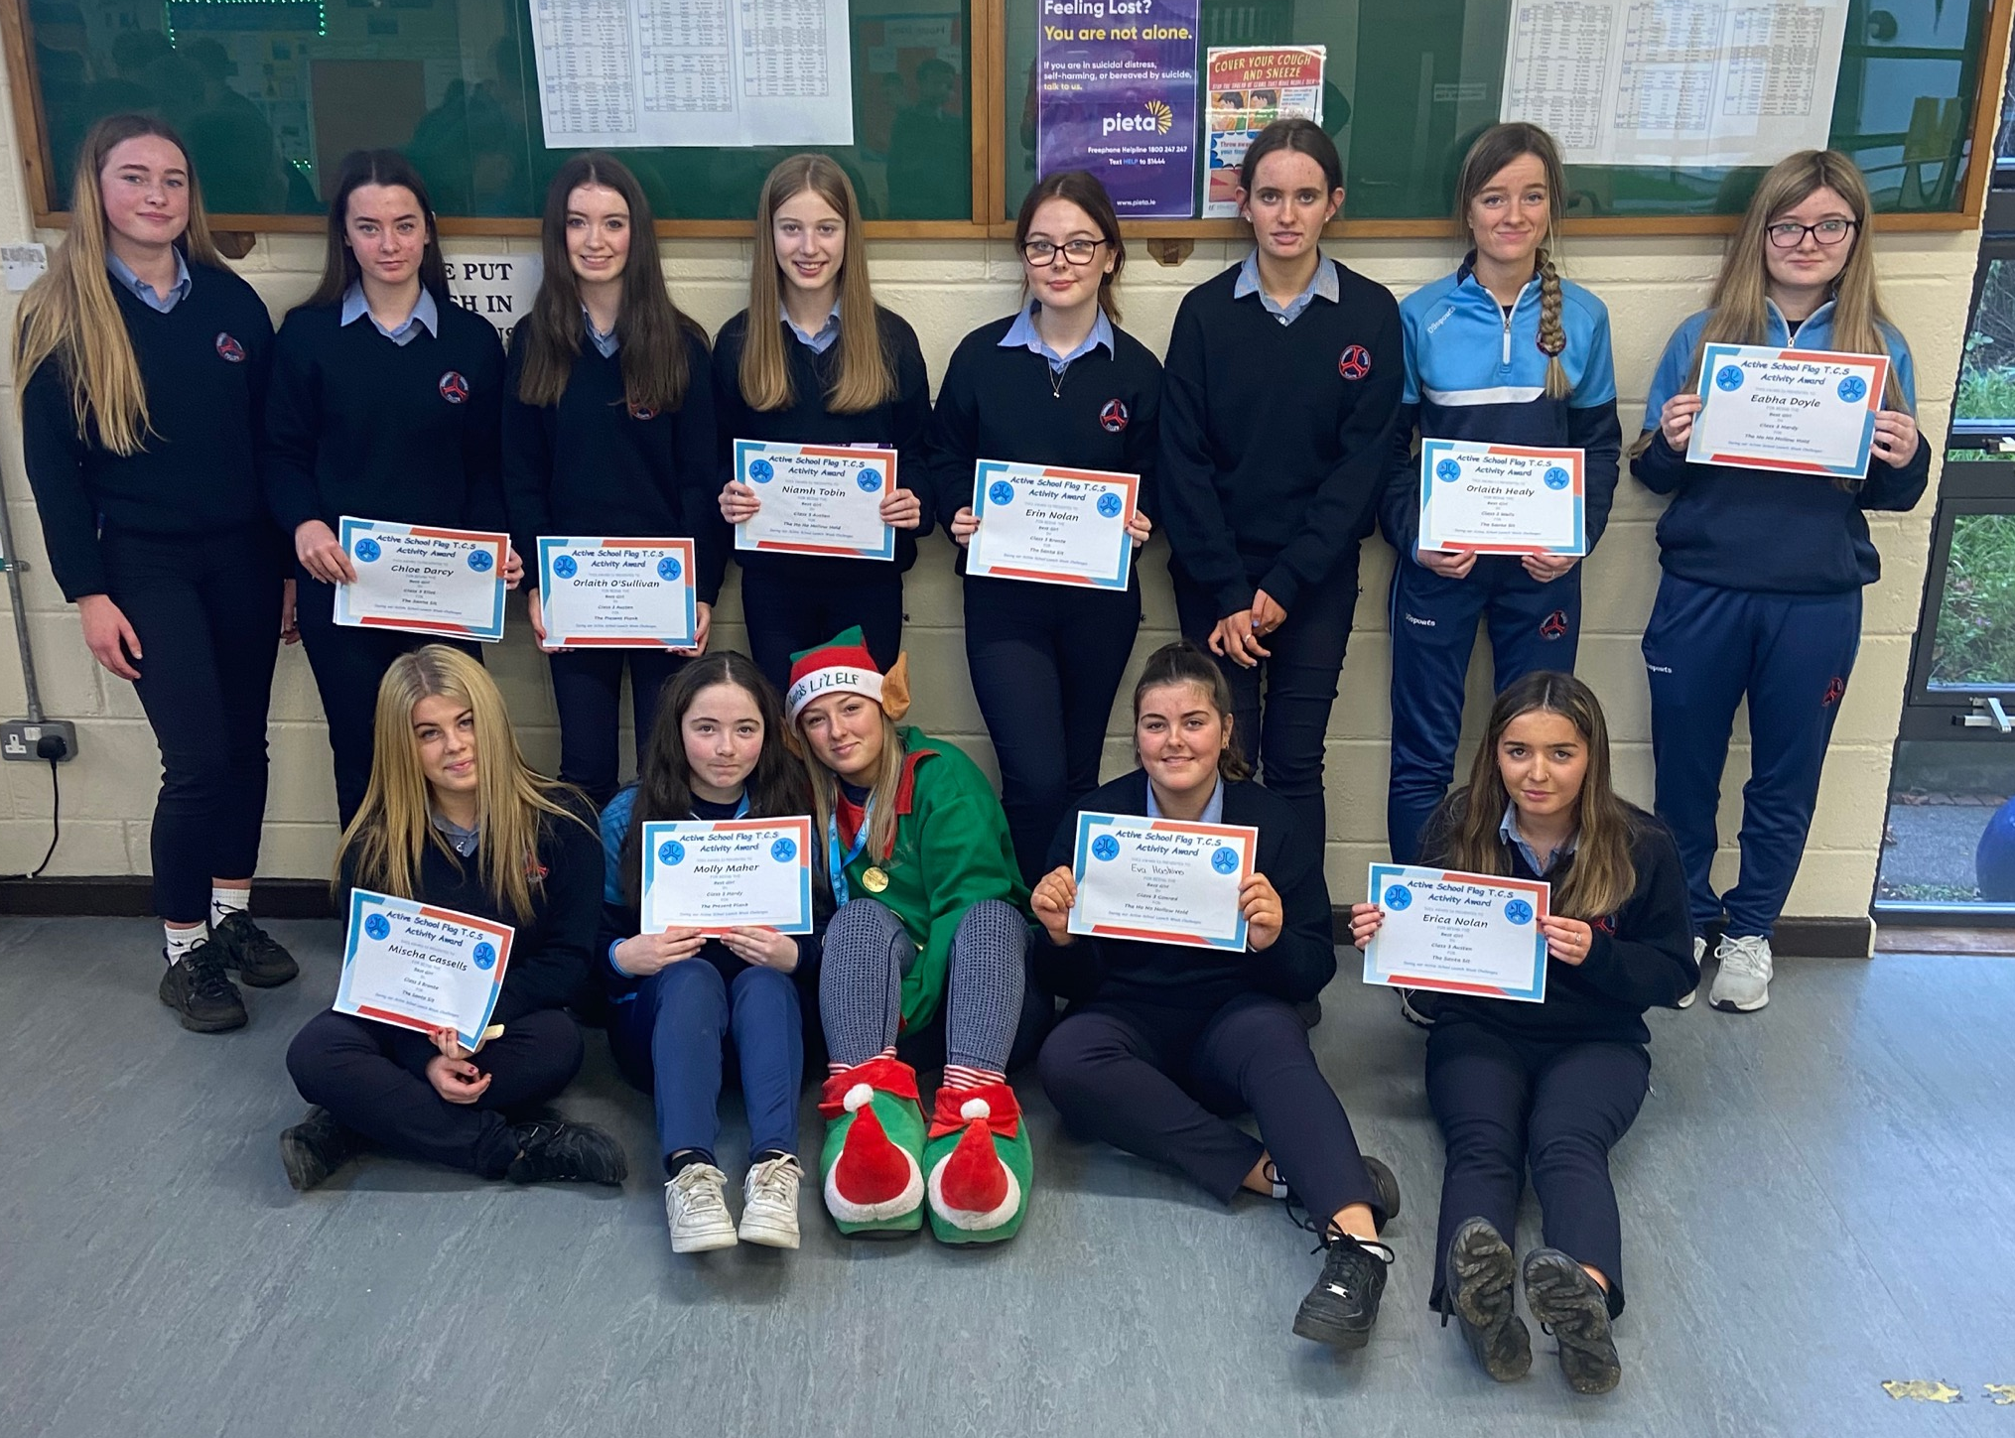
3rd Year Finalists

Slide 25
3rd Year Finalists

Slide 26
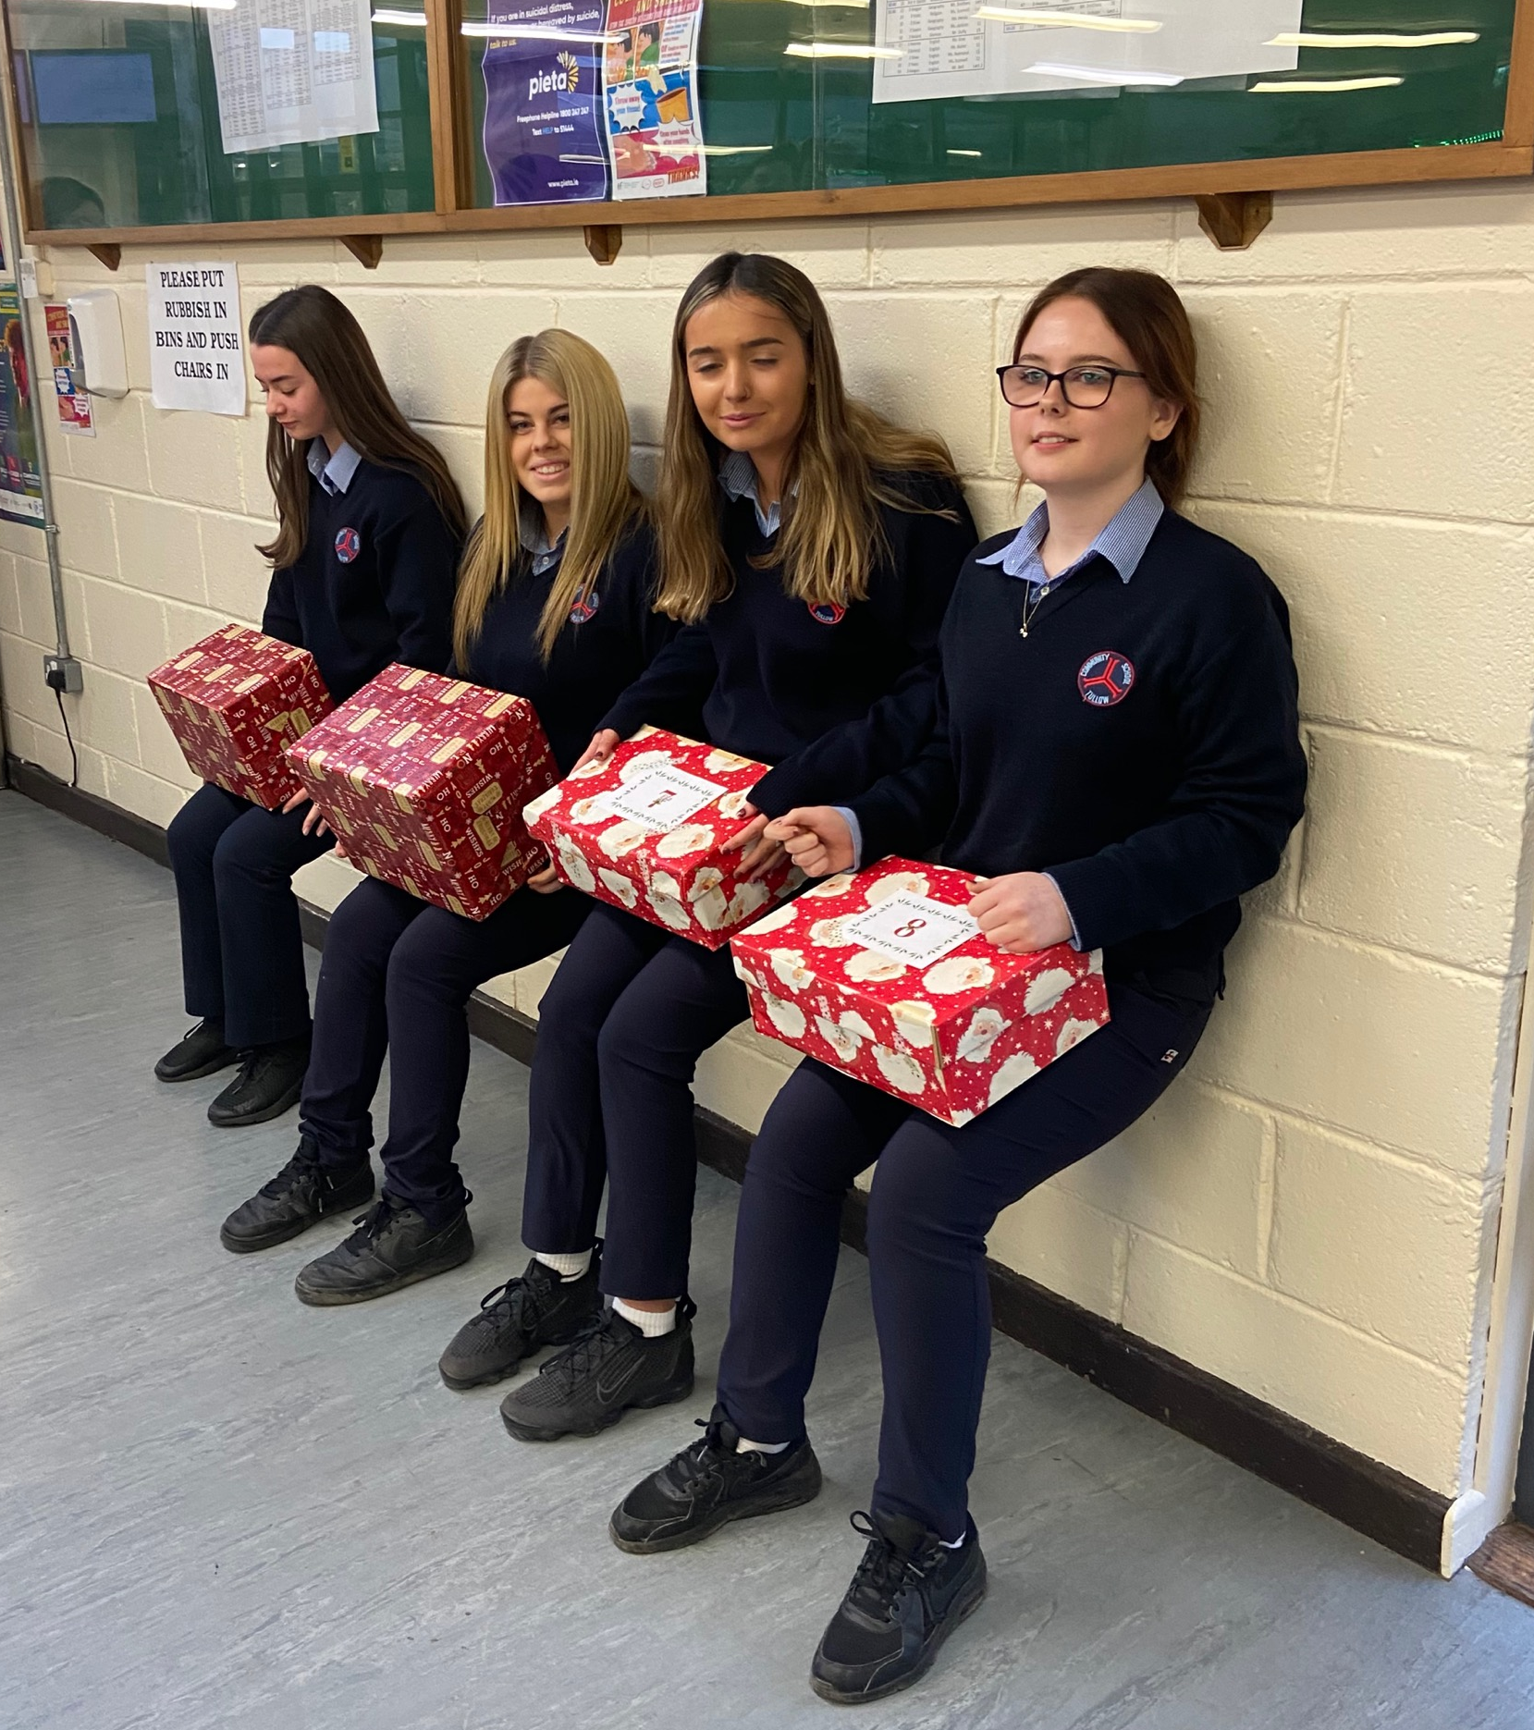
3rd Year Finalists

Slide 27
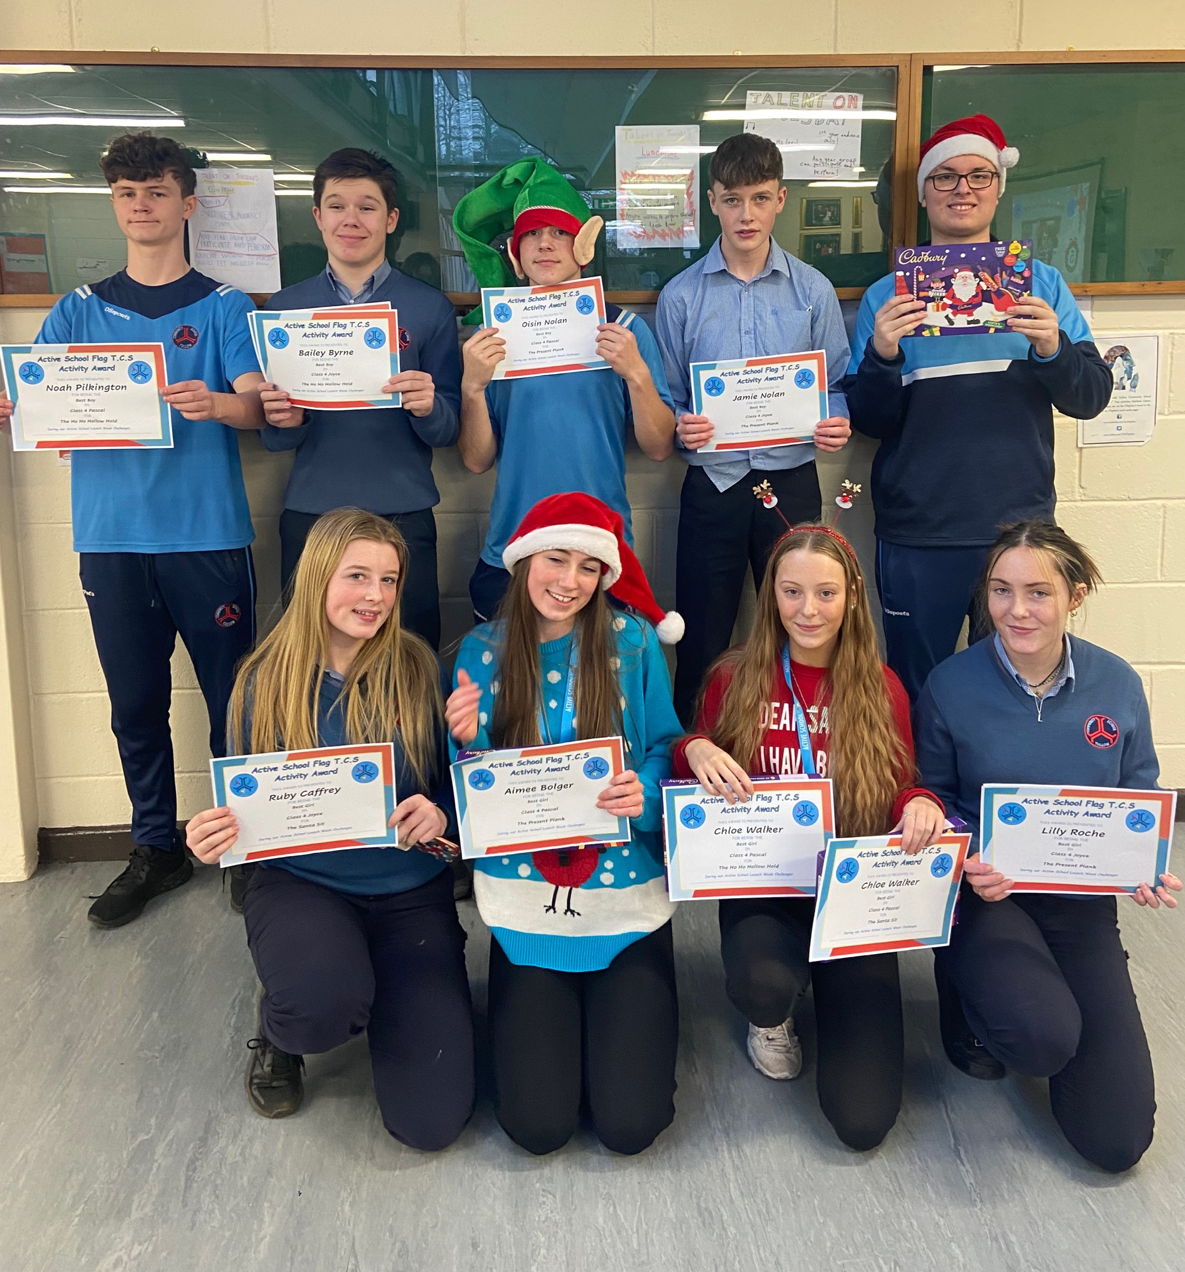
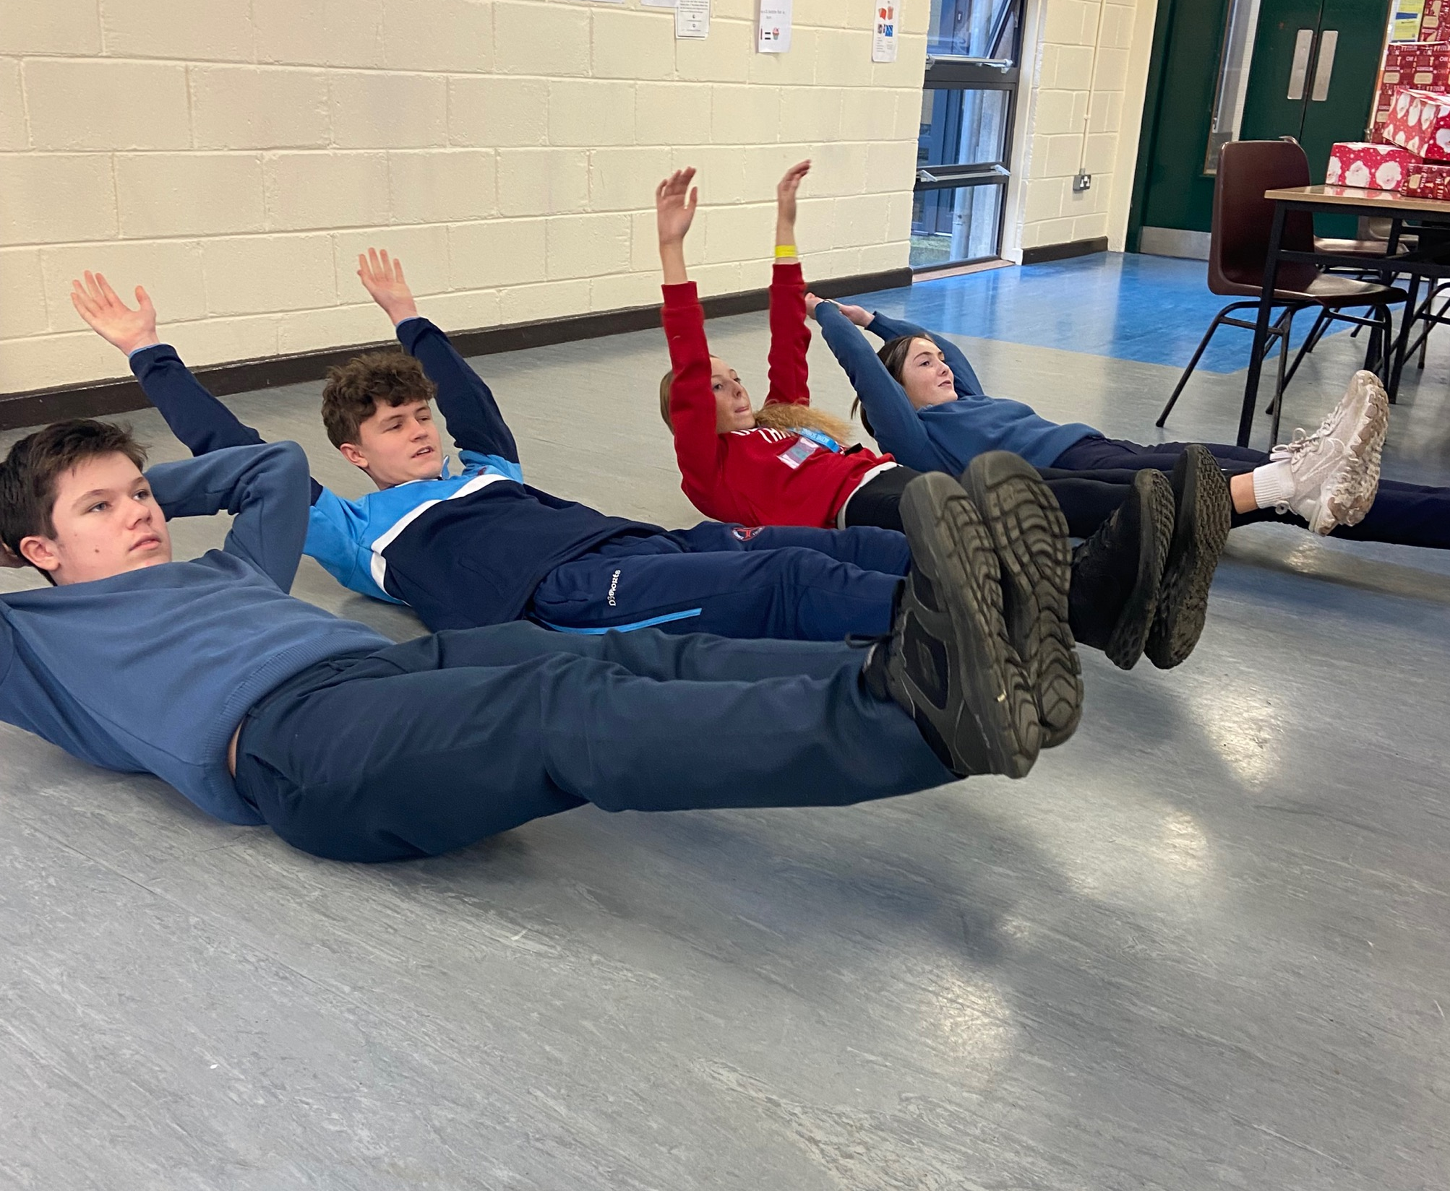
T.Y Finalists

Slide 28
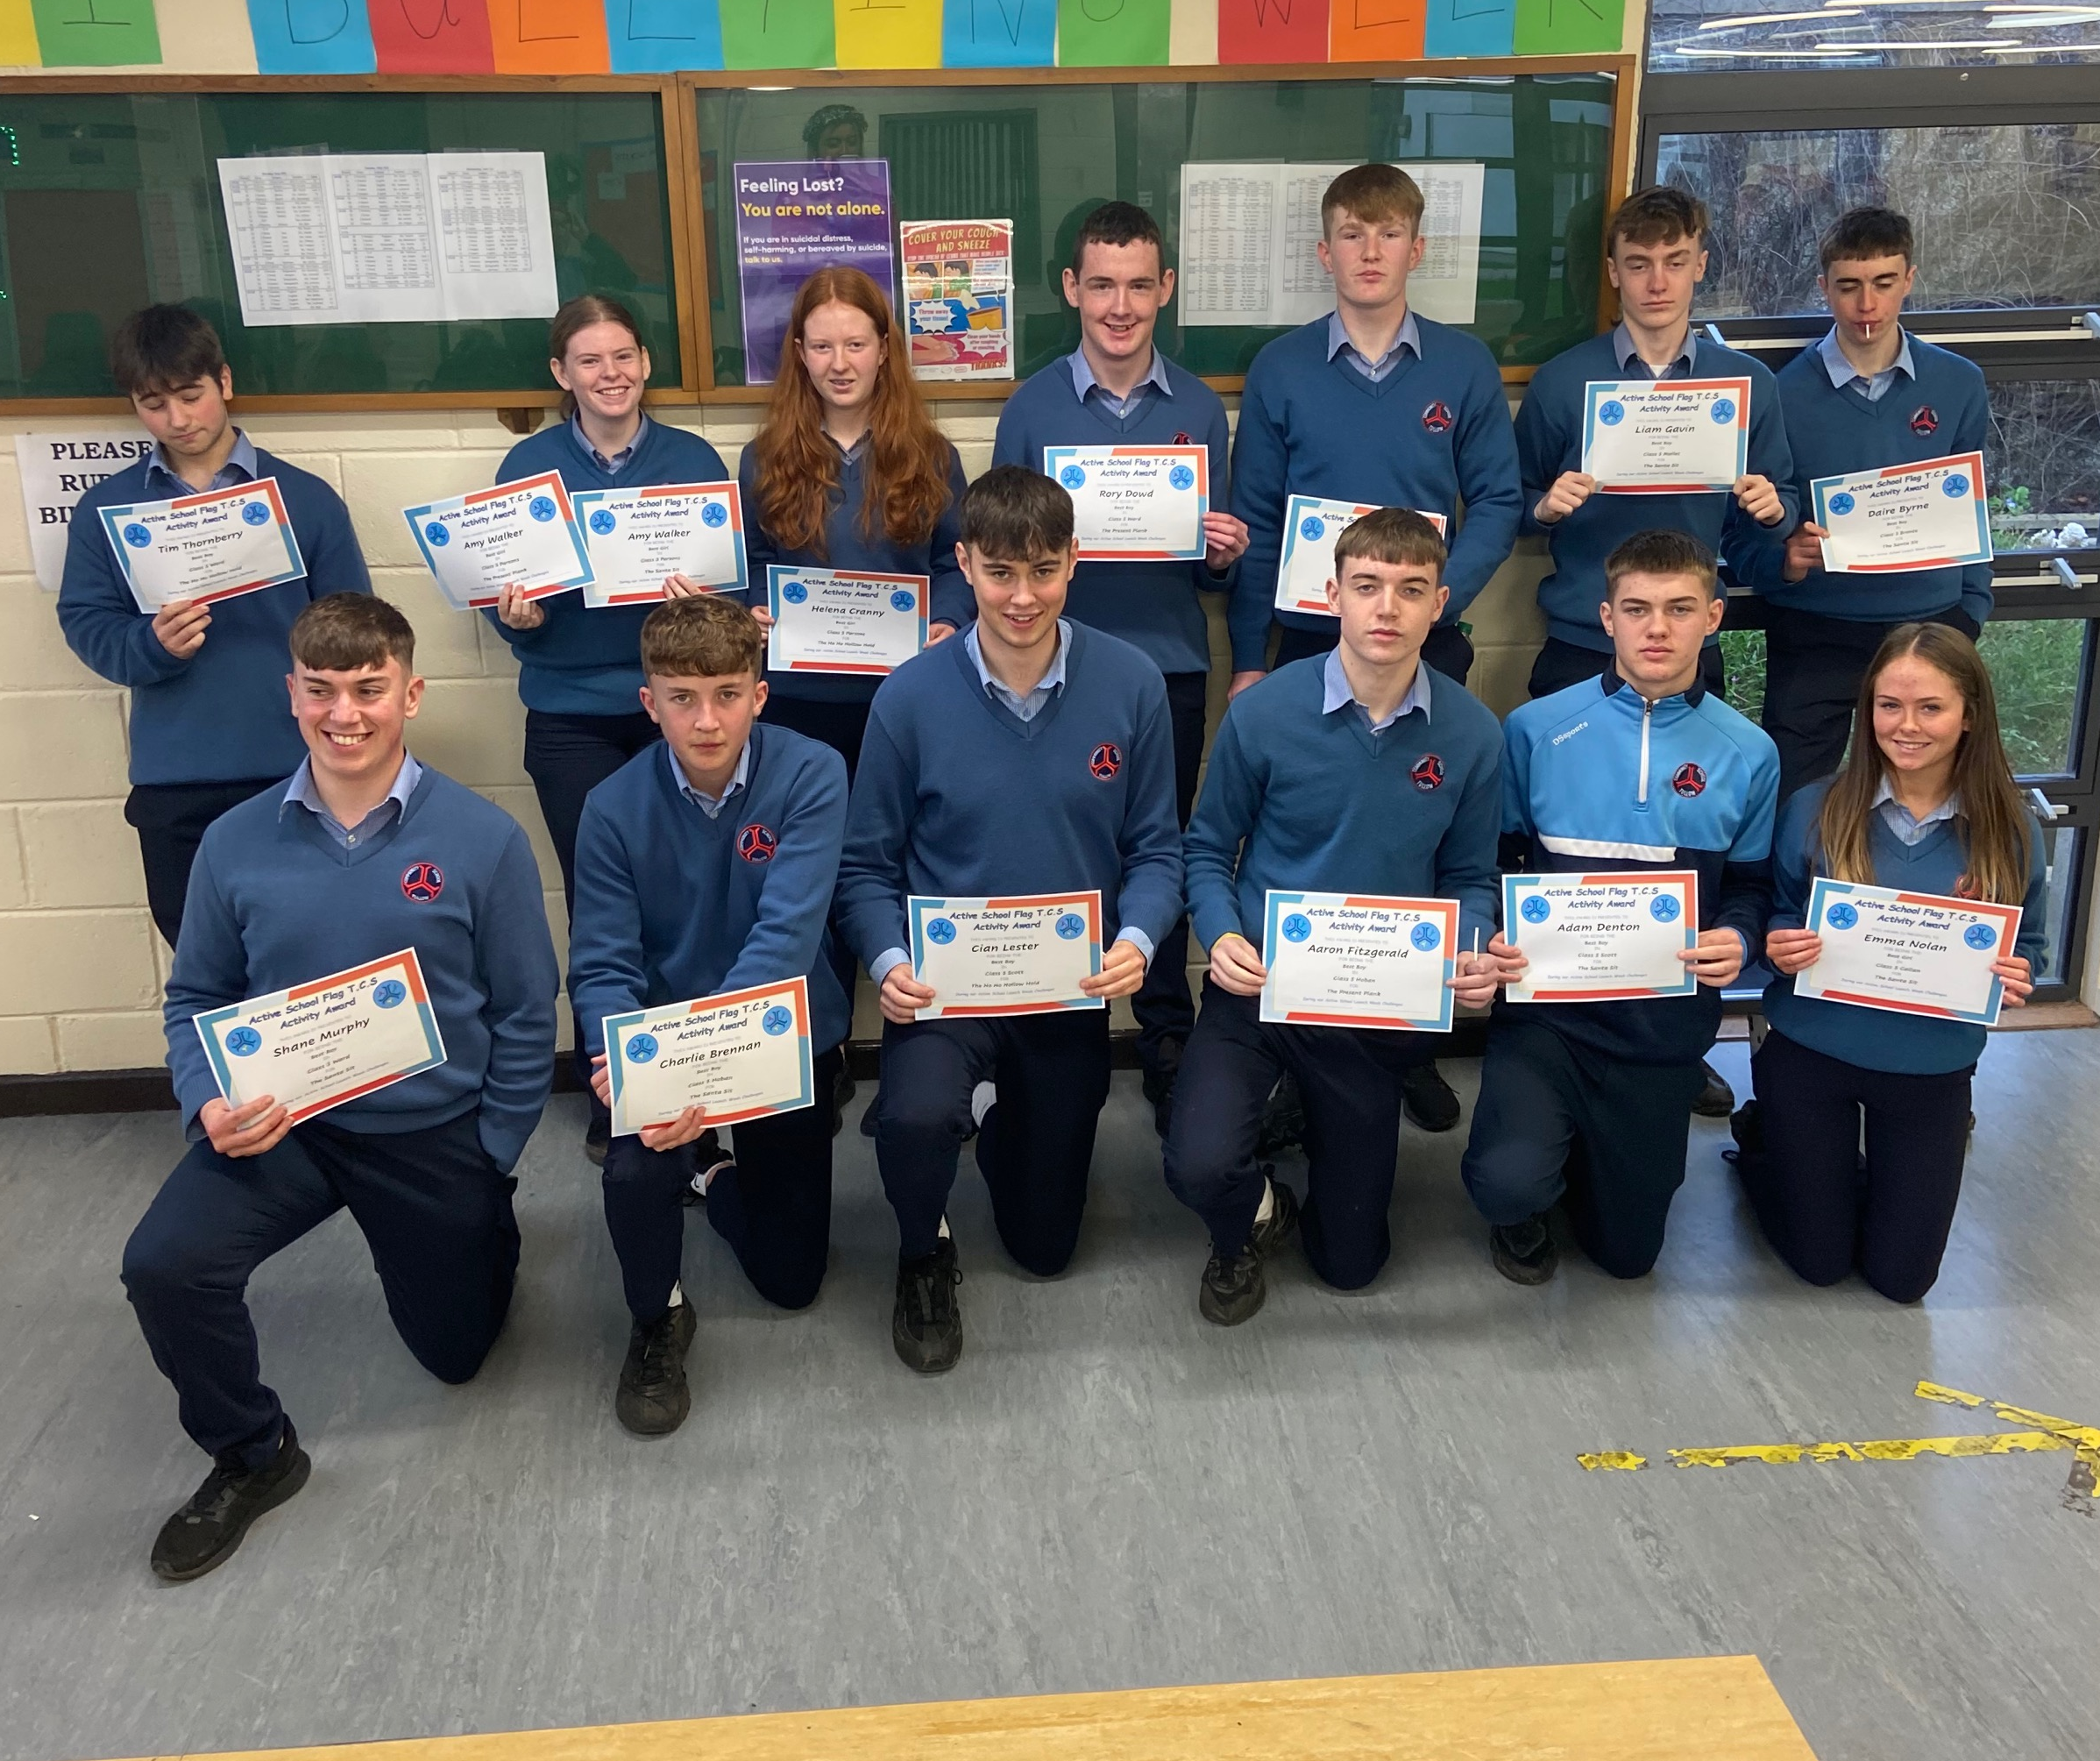
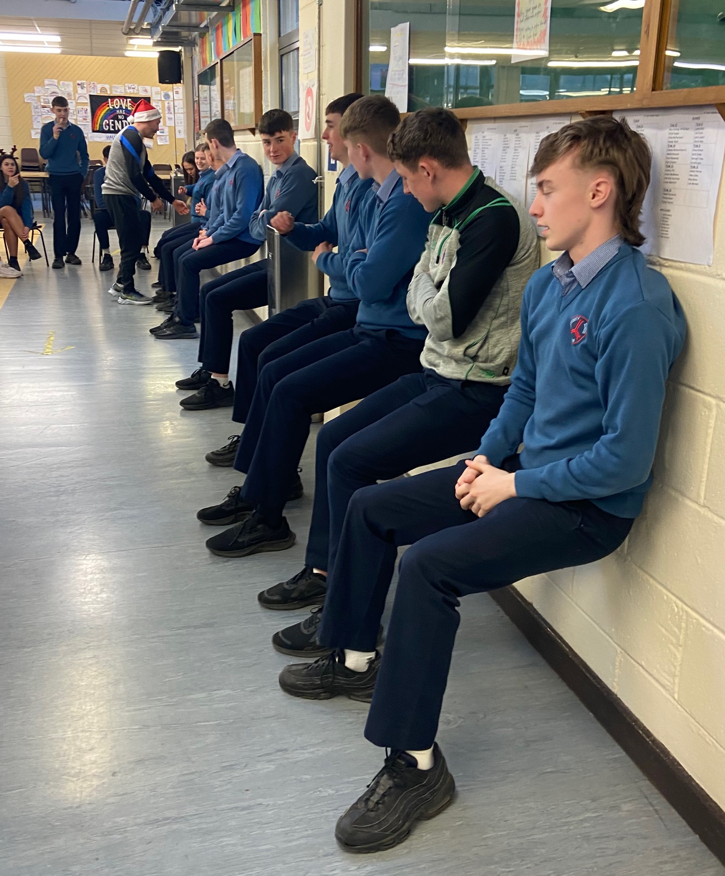
5th Year Finalists

Slide 29
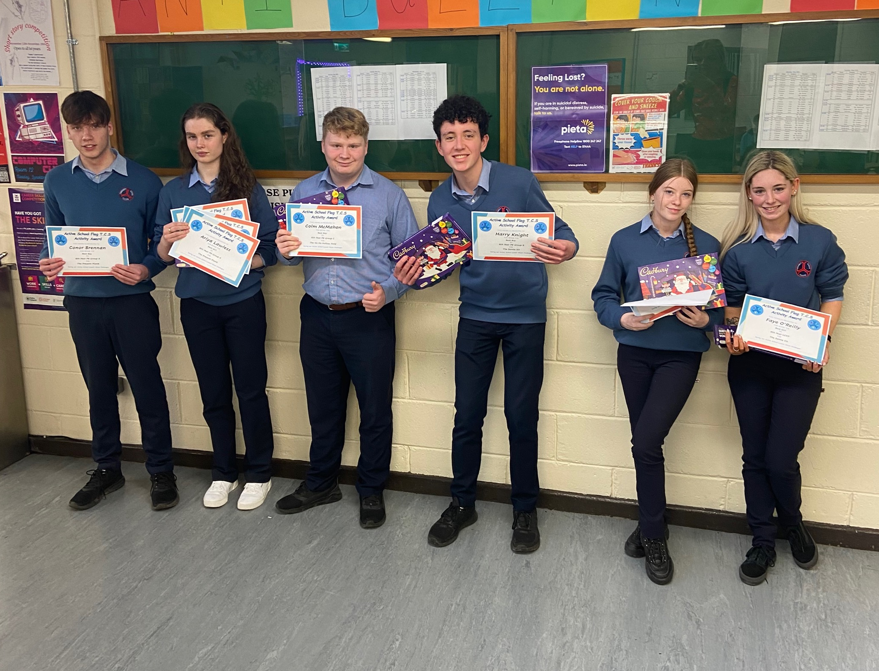
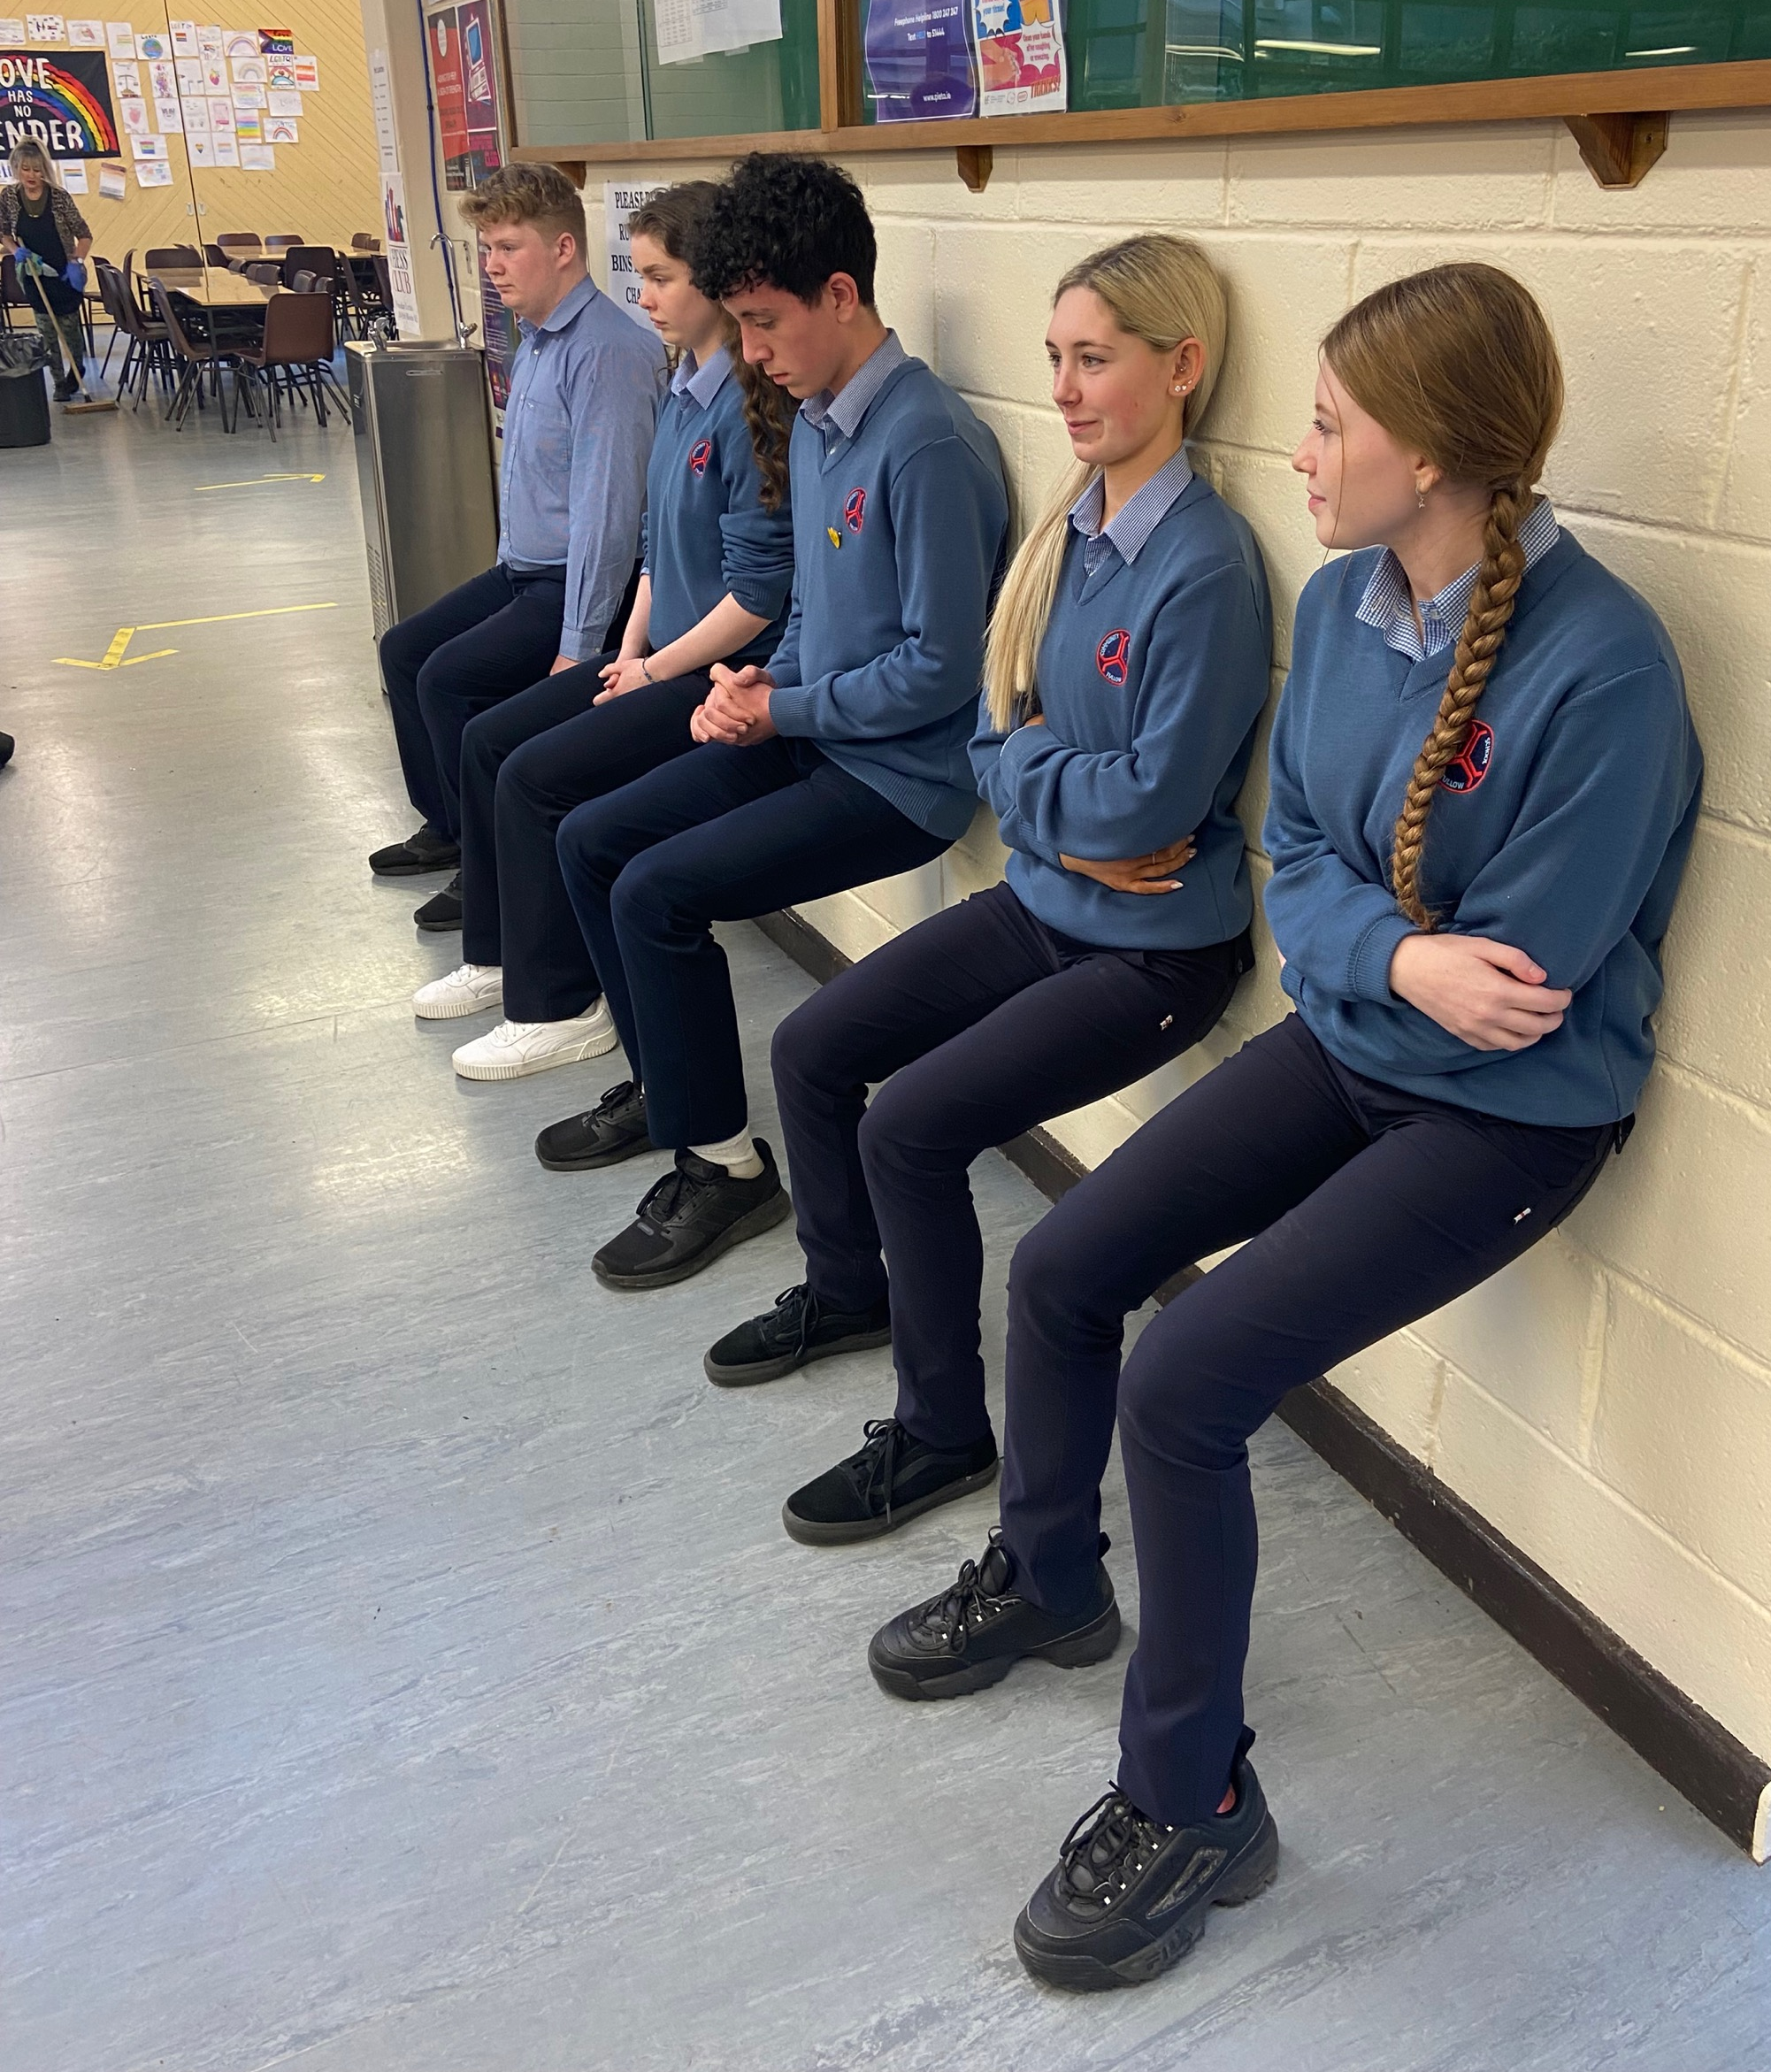
6th Year Finalists

