Slide 1
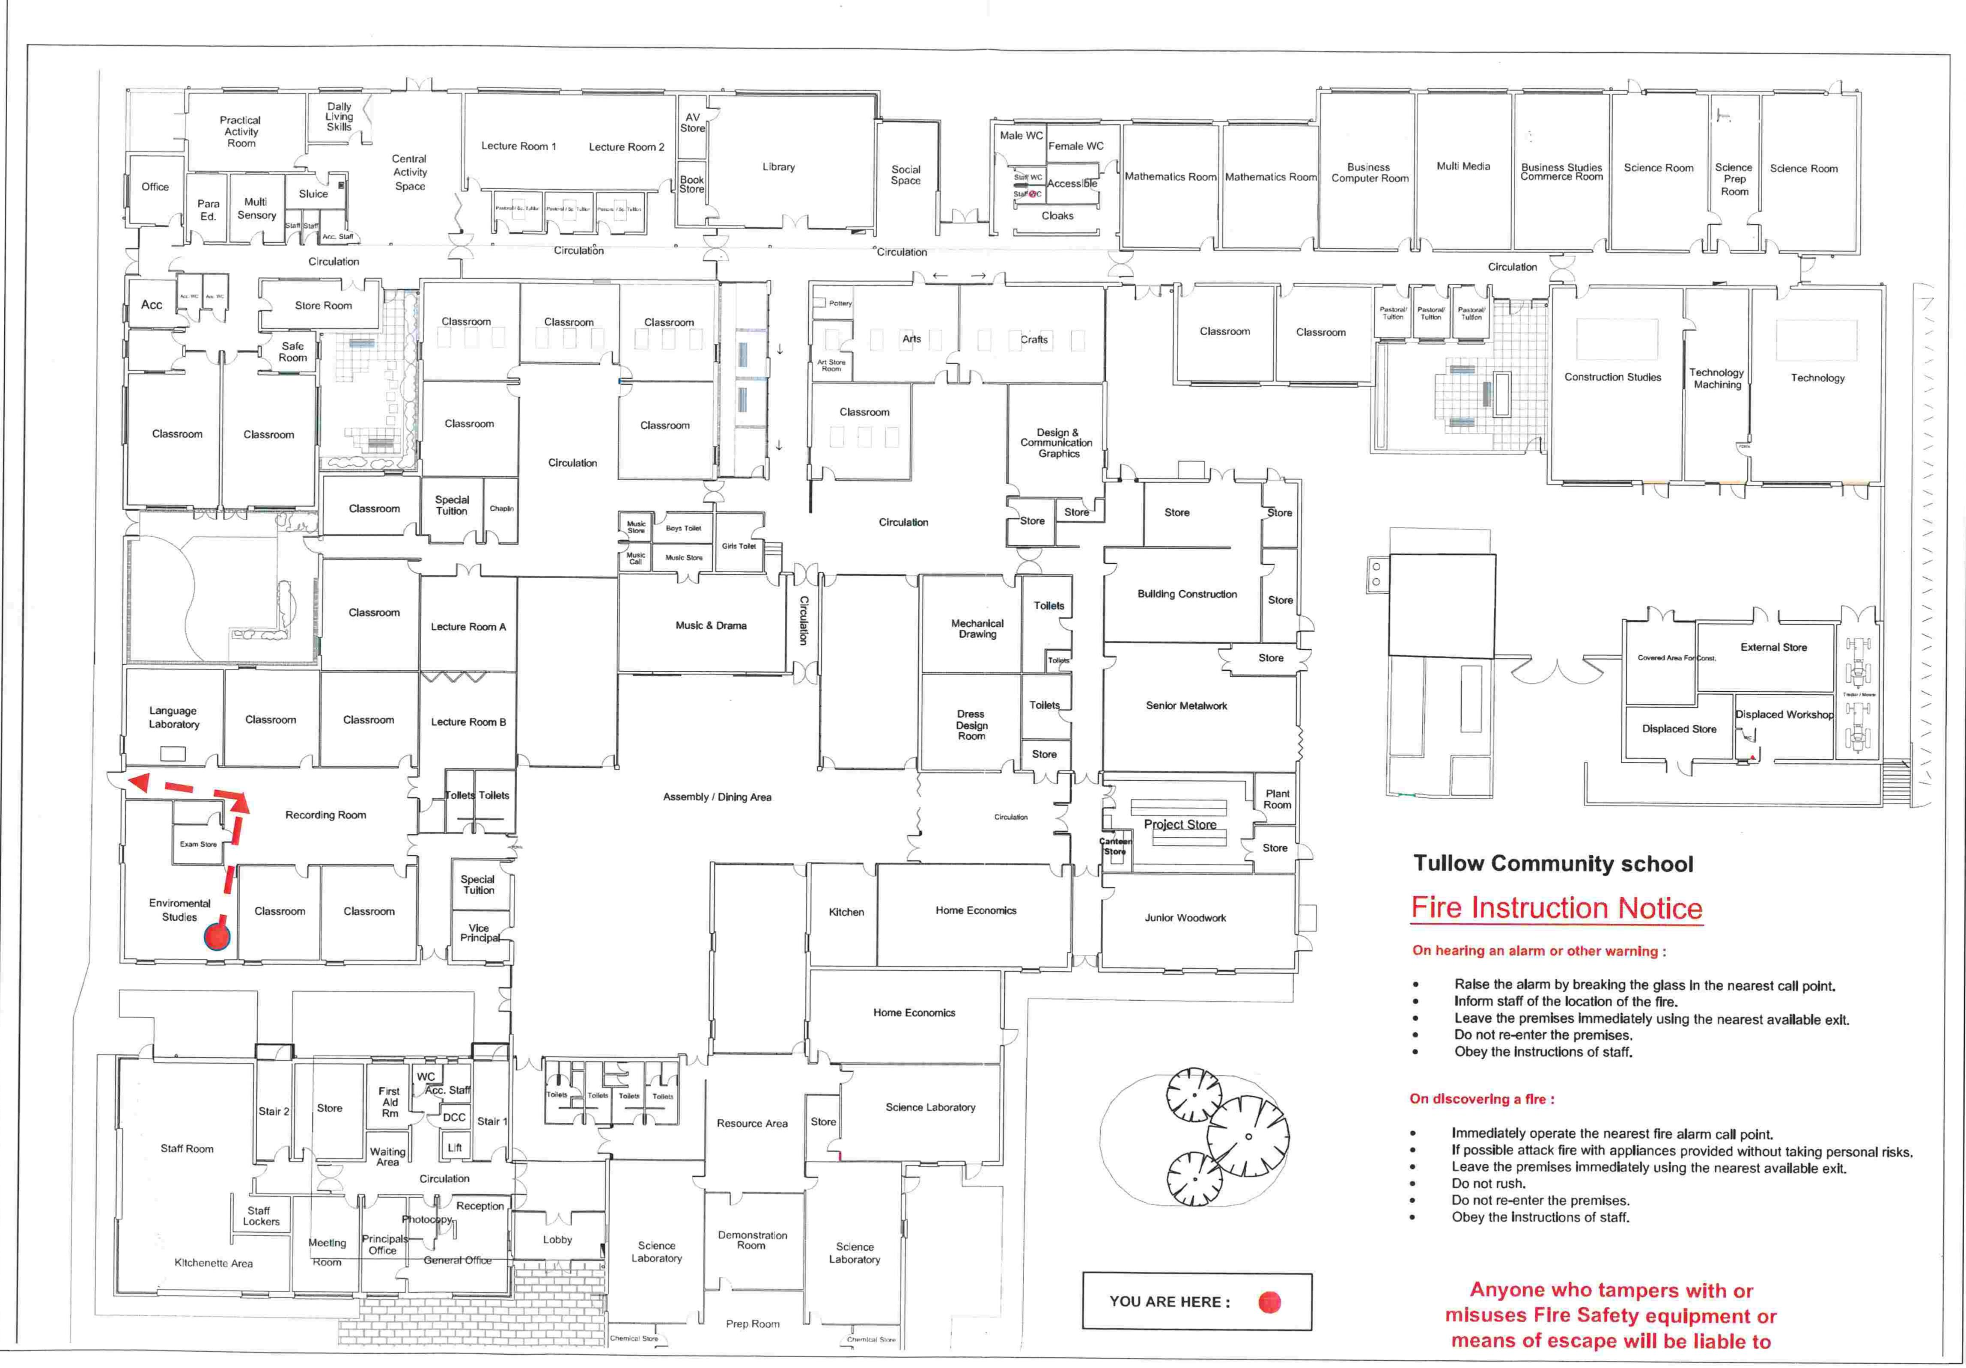
Lec Rm 1
(41)
Lec Rm 2
(42)
Library
Rm 46
Rm 47
Rm 48
D.C.G
Rm 49
Comp
Rm 50
Rm 51
Science
Rm 52
Science
Rm 21
Rm 20
Rm 19
Rm 16
Art
Rm 17
Art
Rm 59
Rm 58
Rm 54
Construction
Rm 53
Engineering
Rm 22
Rm 18
Rm 15
Rm 13
Music
Rm 23
Rm 10
Construction
Morning Entry Points to the School
1st Years- Yellow Area at Room 31
2nd Years- Back Door
3rd Years and Transition Years- Canteen Door
5th Years- Doorway at Room 7
6th Years- Main Door
Moving Between Classes
Upstairs
-One staircase to go up and one to come down.
-Exit through the fire door to the rear of the stairs.
Shared Corridors
-Lecture rooms, Library and Toilets keep left.
-Ramp to the long corridor keep left.
Note
-Leave the Yellow Area and the long corridor
through the fire doors.
-Leave the Red Area through the Garden and back
into the canteen.
-Leave the Blue Area through the Exit at Room 7.
-Leave the Green Area through the Exit at Room 7
or move on the left back towards the canteen and
through the TY area.
-Follow the arrows marked clearly on the floor
-Familiarise yourself with the movements.
Remember “One way in one way out”
Rm 24
Rm 25
Rm 12
Comp
Rm 29
Rm 28
Rm 27
Rm 26
Rm 11
Rm 9
Engineering
Rm 30
Rm 31
Rm 32
Rm 6
Home Economics
Rm 7
Art
Rm 5
Home Economics
Rm 4
Science
Rm 1
Science
Rm 2
Science
Rm 3
Science
One-Way System

